Slide 1
Portfolio Optimization
Team Quantifiers
Arkojyoti Hore
Debaleena Saha
Eric Sargent
Samarpita Chakrabarty

Slide 2
Project Overview
Gain Understanding of Portfolio Optimization
Explore R Shiny Package
Create User Friendly App

Slide 3
Portfolio Optimization- Background Knowledge
Stock: A partial ownership of a publicly traded company
Major Investment Considerations: Risk and Expected Return
Portfolio Optimization: Selecting best allocation of funds to a collection of stocks

Slide 4
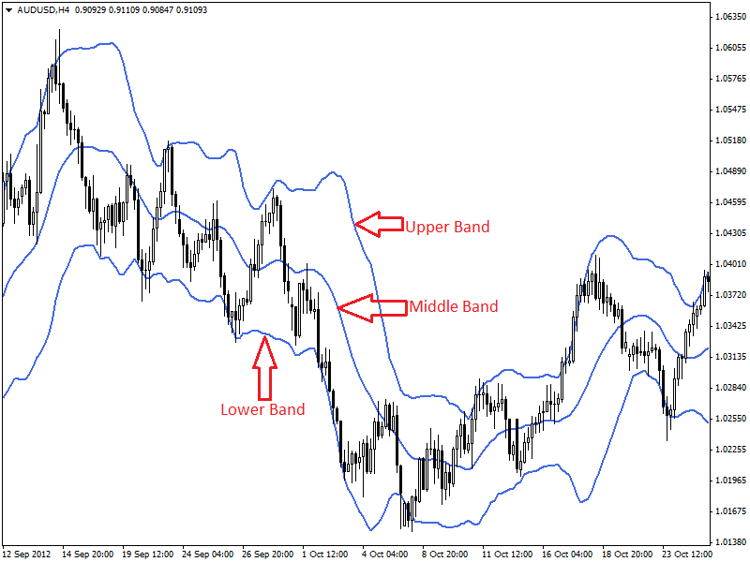
Stock Analysis Tools- Bollinger Bands
Stock Price above upper band-Sell
Stock Price below lower band- Buy

Slide 5
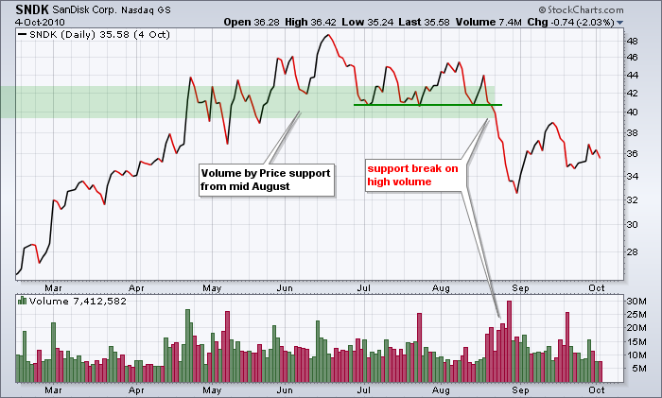
Stock Analysis Tools- Volume
How much of a company stock is being traded
Good assessment of stock liquidity

Slide 6
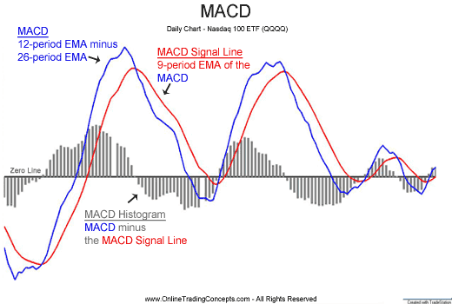
Stock Analysis Tools- Moving Average
When MACD above Signal Line, BUY
When MACD below Signal Line, SELL

Slide 7
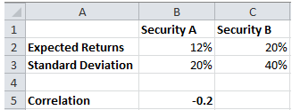
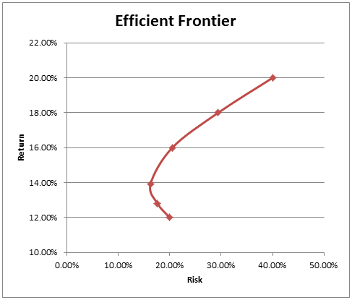
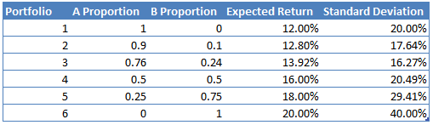
Portfolio Optimization- Efficient Frontier
Expected Return =
Volatility =

Slide 8
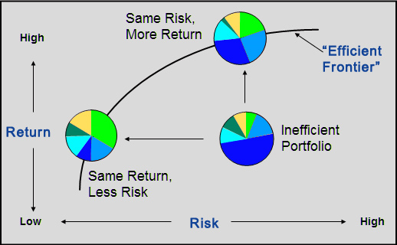
Portfolio Optimization- Sharpe Ratio
Determines where on efficient frontier the portfolio should fall

Slide 9
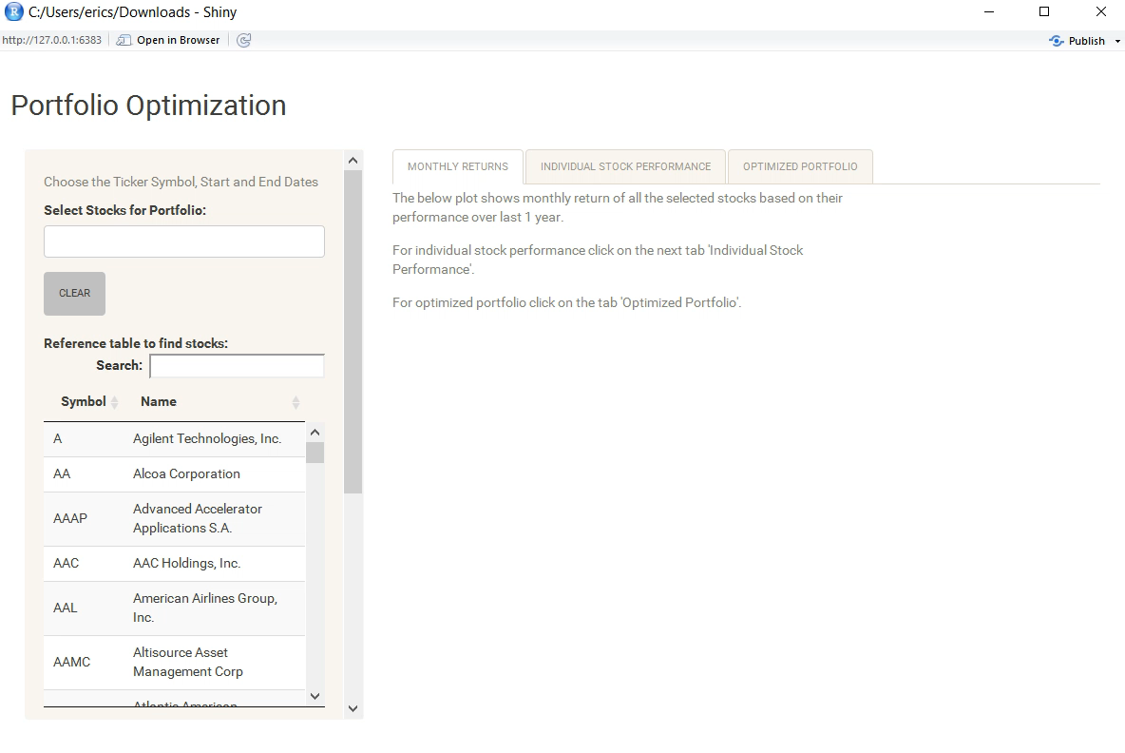
App Demo

